Slide 1
Applied Data Science Portfolio
Trevor Kahl

Slide 2
Program Learning Outcomes
Describe a broad overview of the major practice areas of data science.
Collect and organize data.
Identify patterns in data via visualization, statistical analysis, and data mining.
Develop alternative strategies based on the data.
Demonstrate communication skills regarding data and its analysis for managers, IT professionals, programmers, statisticians, and other relevant professionals in their organization.
Synthesize the ethical dimensions of data science practice (e.g., privacy).

Slide 3
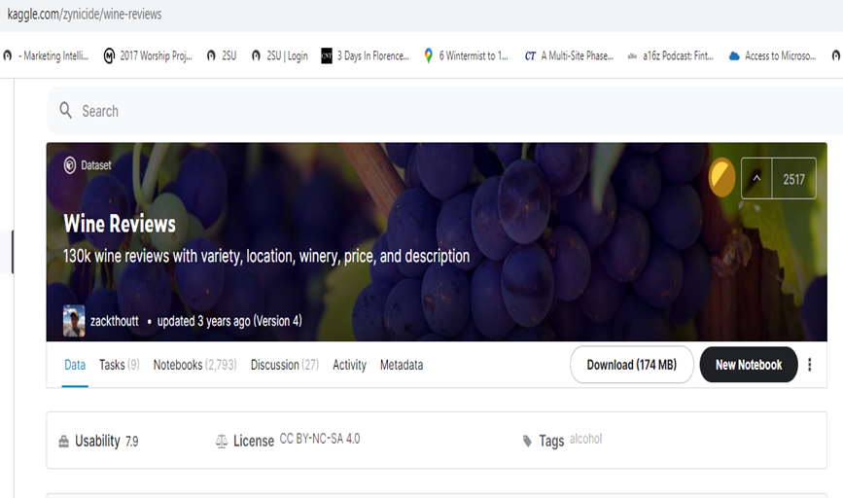
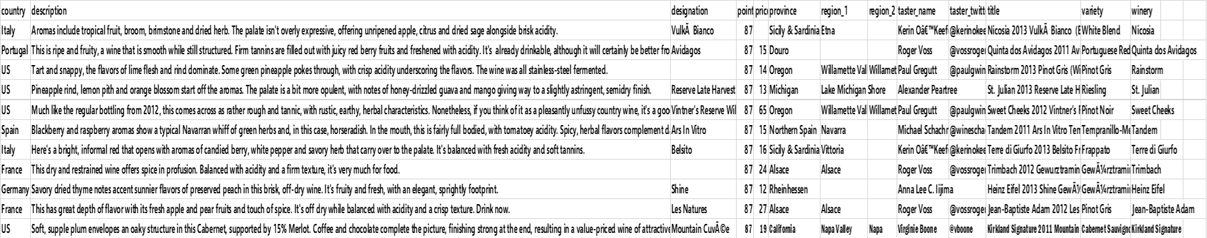
IST 652
Country, providence and regions of origin of wine
Description of wine
Designation of wine
Points awarded to wine
Price of one bottle of wine
Information on points awarder
Variety of wine
Winery the wine is made in
Notes:
Python

Slide 4

Wine Twitter Sentiment
Wine Twitter Sentiment
Getting and cleaning the tweets
Number of tweets for each analysis was 2500 tweets
Used TextBlob for sentiment analysis of tweets
#Syrah Positive tweets percentage: 30.337078651685392 %
Negative tweets percentage: 2.247191011235955 %
Neutral tweets percentage: 67.41573033707866 % \

Slide 5
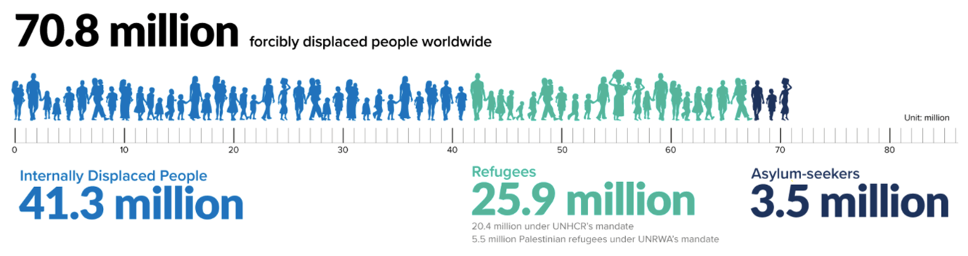
IST 707
Notes:
R
United Nation’s High Commissioner for Refugees data
Original Attributes (UNHCR)
Attribute
Description
Country
List of country name (same in both Origin and Destination tables)
2010
Total aggregate count of applications either to or from the country (depending on table) in the year 2010
2011
Total aggregate count of applications either to or from the country (depending on table) in the year 2011
2012
Total aggregate count of applications either to or from the country (depending on table) in the year 2012
2013
Total aggregate count of applications either to or from the country (depending on table) in the year 2013
2014
Total aggregate count of applications either to or from the country (depending on table) in the year 2014
Total
Total numeric count of applications from 2010-2014
Annual change ’14-‘13
Percent change in applications from 2013 to 2014
Rank2014
Categorical ranking of high number of applications for just 2014
Rank2010-2014
Categorical ranking of high number of applications for 2010-2014
Per1000Inhabitants2014
Scaled number of applications per 1000 inhabitants in the country (AKA a control for population) for 2014
Per1000Inhabitants2010-2014
Scaled number of applications per 1000 inhabitants in the country (AKA a control for population) for 2010-2014
Rank1000_2014
Categorical ranking of 1000 inhabitant scaled applications for just 2014
Rank1000_10-14
Categorical ranking of 1000 inhabitant scaled applications for 2010-2014
Per1USDGSP2014
Scaled number of applications per 1 USD/GSP per capita in the country (AKA control for GDP) for 2014
Per1USDGSP2010-2014
Scaled number of applications per 1 USD/GSP per capita in the country (AKA control for GDP) for 2010-2014
RankGDP_2014
Categorical ranking of applications per 1 USD/GDP per capita for just 2014
RankGDP_2010-2014
Categorical ranking of applications per 1 USD/GDP per capita for 2010-2014
with Freedom House Information
Appended Attributes (Freedom House)
Attribute
Description
Region
Geographical region, as a factor (Europe or Asia)
Free
Indication of freedom status as Free, Not Free, or Partially Free (F, NF, PF)
PoliticalRights
Numeric rating from 1-7 (1 most free, 7 least free)
CivilLiberties
Numeric rating from 1-7 (1 most free, 7 least free)
Governance
Function of government, score from 1-12 (1 poor, 12 best)
Expression
Freedom of expression and belief rating 1-16 (1 poor, 16 best)
Electoral
Electoral process rating 1-12 (1 poor, 12 best)
PolPluralism
Political pluralism and participation rating 1-12 (1 poor, 12 best)
IndividualRights
Personal authority and individual rights rating 1-16 (1 poor, 16 best)
RuleofLaw
Rule of law rating 1-16 (1 poor, 16 best)
Organization
Association and organizational rights 1-12 (1 poor, 12 best)
PolRights
Score from 1-40 (total of Electoral, PolPluralism, and Government)
Liberties
Score from 1-60 (total of Expression, Organization, IndividualRights, and RuleofLaw)

Slide 6
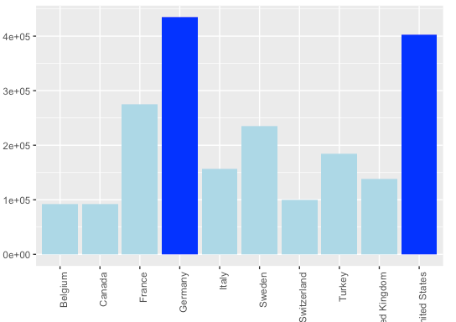
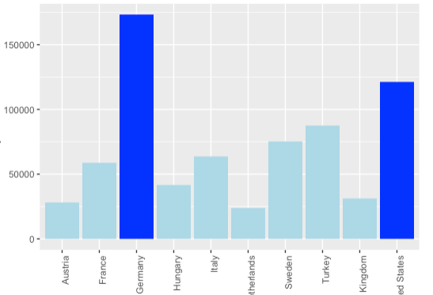
Top Countries – Aggregate
2010-2014
2014
Notes:
Initial analysis was also conducted on the aggregate totals and scaled total values. The below are depictions of the top 10 ranked countries for each category for origin countries, with the top two in royal blue:

Slide 7
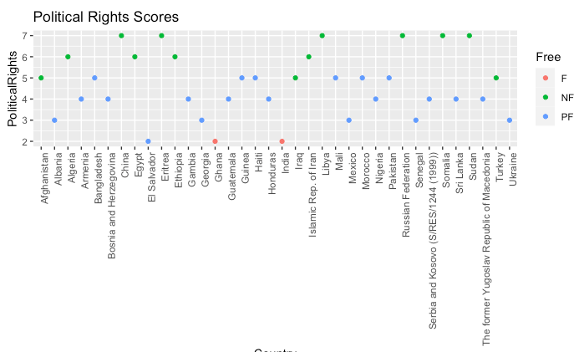
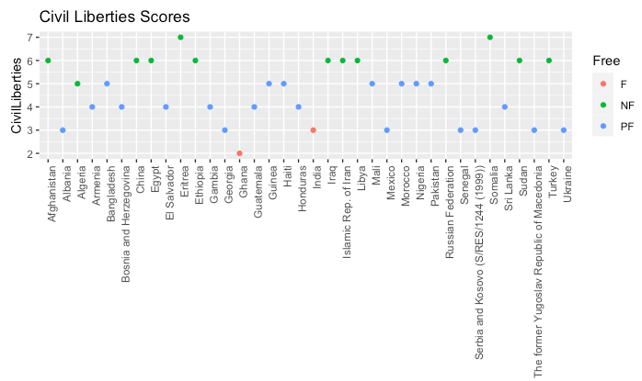
Notes:
Origin countries freedom indices

Slide 8
Association Rule Mining for Submitted Applicants
lhs rhs support conf lift
{2010=small, Rule of Law=mid-low} => {2013=small} 0.2 0.8 1.07
{2010=small, Rule of Law=mid-low} => {2014=small} 0.2 0.8 1.10
{Free=F,Governance=mid-high} => {2013=small} 0.3 0.8 1.07
{Civil Liberties=1,Rule of Law=high} => {2010=small} 0.3 0.8 0.97
{Political Rights=1,Governance=mid-high} => {2012=small} 0.2 0.8 1.14
{Governance=mid-high,Organization=high} => {2012=small} 0.3 0.8 1.14
{2013=small-high,Liberties Score=F} => {2012=small-high} 0.1 1 5
Notes:
The purpose of Association Rule Mining (ARM) is to determine interesting and viable relations in variables to see if the data can be explained by certain variables. In the case of this analysis, the team was interested in looking at where refugees were going to and originating from. With this the team was interested if the variables could define a trend that could be pointed towards with a strong and reliable correlation towards predicting trends.
The trends that come from the rules can be identified with reason that if something occurs then it can be explained by certain factors. The reliability of these rules can be deemed from the confidence, support, and lift. With these values the rules can be identified to be trusted for future analysis when collecting further data on more countries.

Slide 9
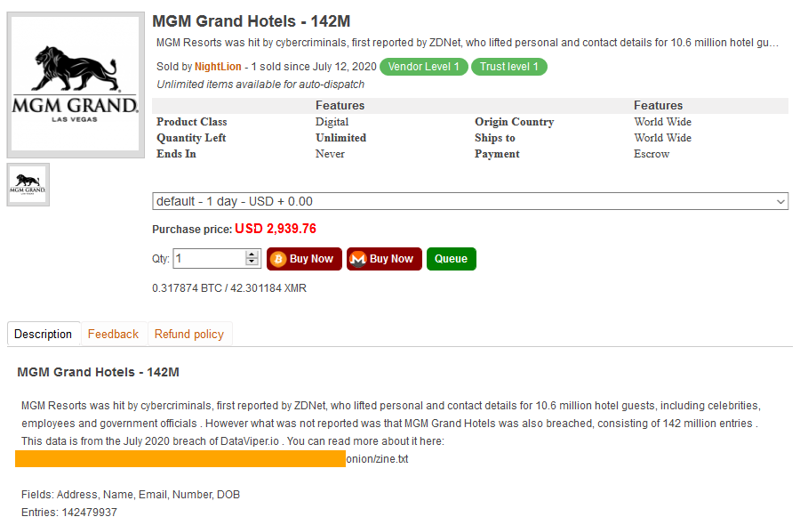
IST 623
Notes:
Refer to other data sets that were spoken of
First reported in February 2020, but hack occurred in July of 2019
10.6 million MGM hotel guests' data was offered as a free download on a hacking forum
Users now face a higher risk of receiving spear-phishing emails, and being SIM swapped
Twitter CEO Jack Dorsey, pop star Justin Bieber, and DHS and TSA officials are some of the big names Under the Breach spotted in the leaked files

Slide 10
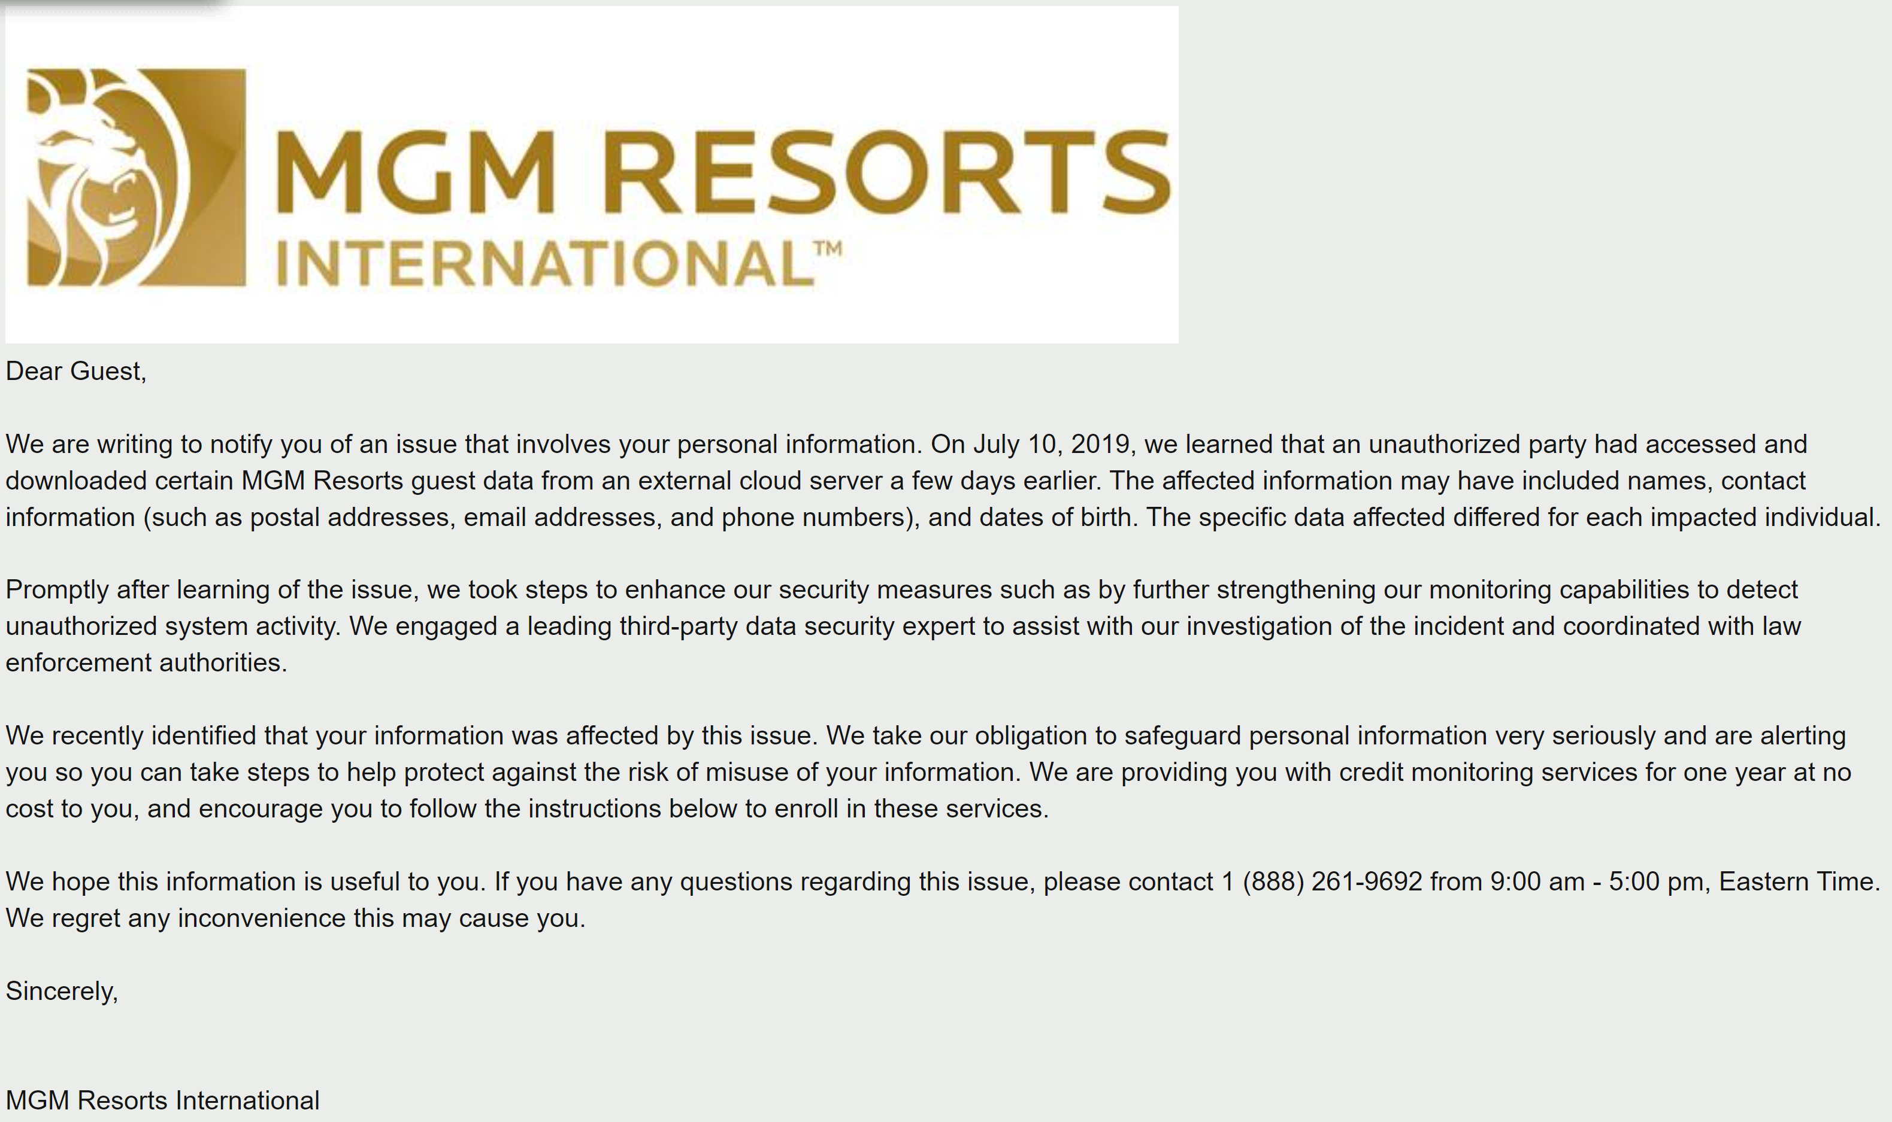
Customer Interpretation

Slide 11

5 Ways to Mitigate
Change passwords
If you don’t already have it, set up credit monitoring
Practice good cybersecurity habits
Keep a record of your response
Stay alert
Notes:
As suggested by: https://www.cnbc.com/2020/02/20/mgm-data-breach-5-things-you-should-do-if-you-were-affected.html

Slide 12
Conclusion
Describe a broad overview of the major practice areas of data science
Collect and organize data in IST 652 and IST 707
Identify patterns in data via visualization, statistical analysis, and data mining in IST 707
Develop alternative strategies based on the data using both Python and R
Demonstrate communication skills regarding data and its analysis for managers, IT professionals, programmers, statisticians, and other relevant professionals in their organization
Synthesize the ethical dimensions of data science practice (e.g., privacy) with IST 623
Moving forward into the field of Data Science
Looking for the data and it’s inherent value
Applying the skills (Python, R, SQL, etc.) learned in the program to my current position and future endeavors

